Slide 1
Does real-time transit information reduce waiting time?
Measuring Real-time Information’s Impact on Public Transit Trip Waiting Time Using High-resolution Real-time data
Luyu Liu, Harvey Miller
Notes:
Hello everyone, my name is Luyu Liu. Today I would like to see the measure the real-time information’s impact on public transit user’s waiting time using high-resolution real-time data

Slide 2
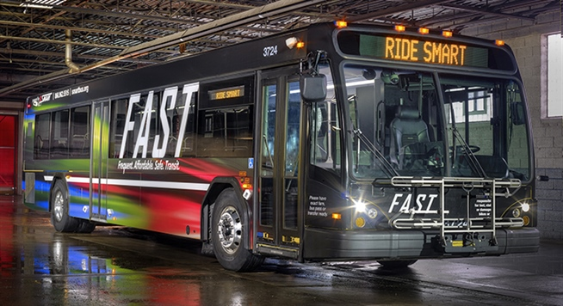
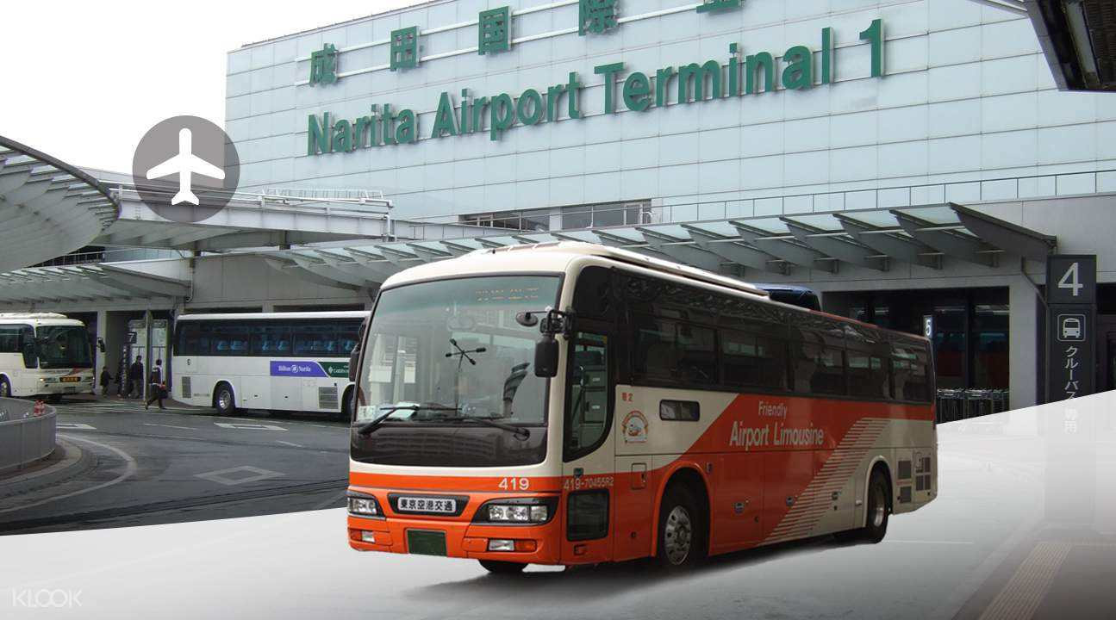
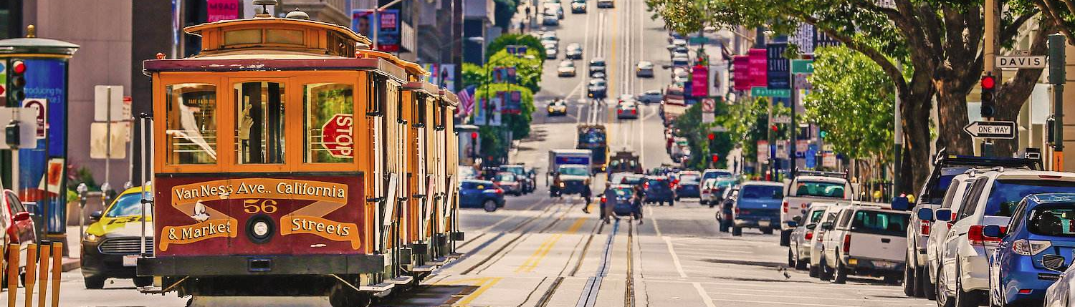
Everything Wrong with
The way you used public Transit
In 7 minutes or less…
(Jargons!)
Duh…

Slide 3
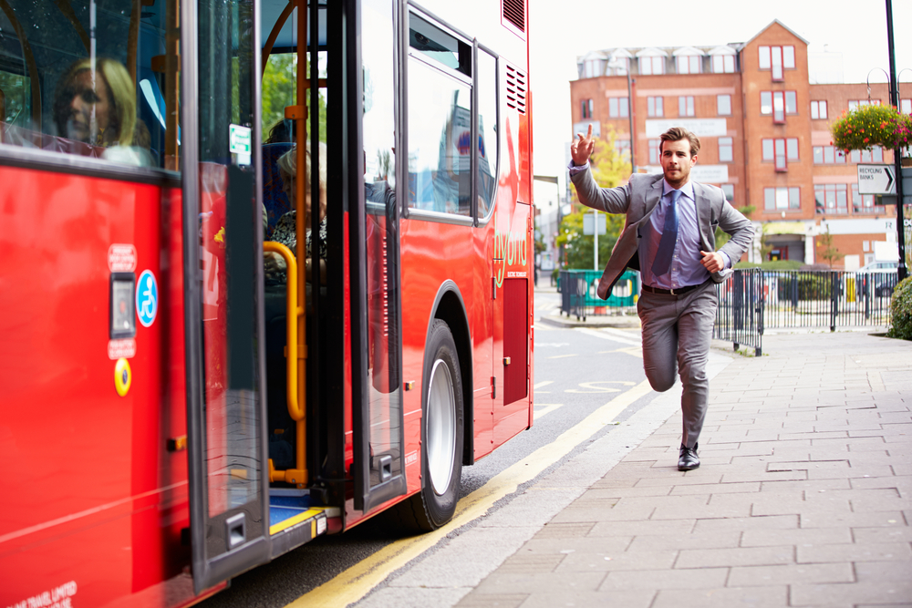
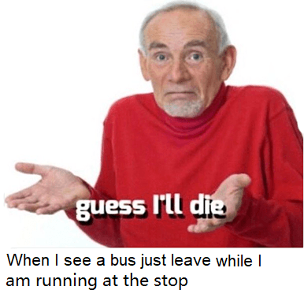

Slide 4

To minimize the waiting time!

Slide 5
Trip planning strategy
How to plan your trip?
When to leave for the bus?
I’ll just leave home randomly
I’ll follow the schedule
How about I live at stop
I’ll wait the last minute until the mobile app nudged me
I’ll leave a buffer in front of the app suggested time

Slide 6
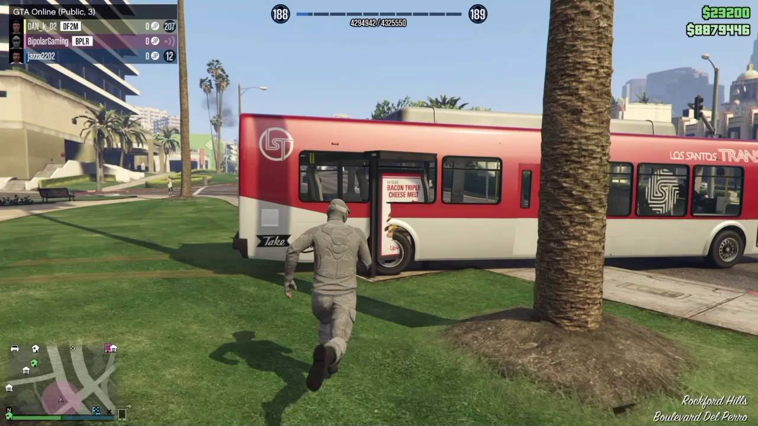
Arbitrary tactic

Slide 7
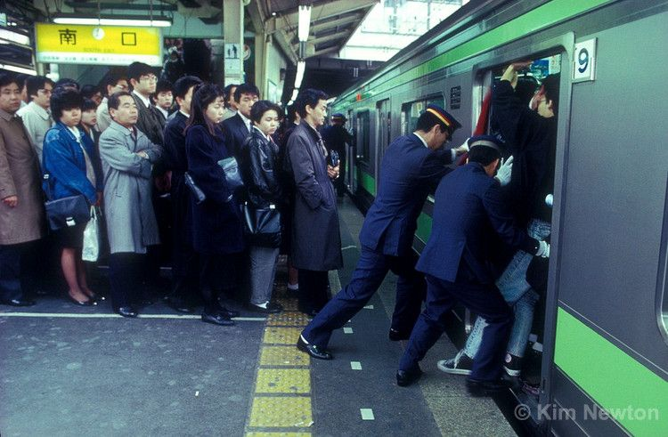
Schedule tactic

Slide 8
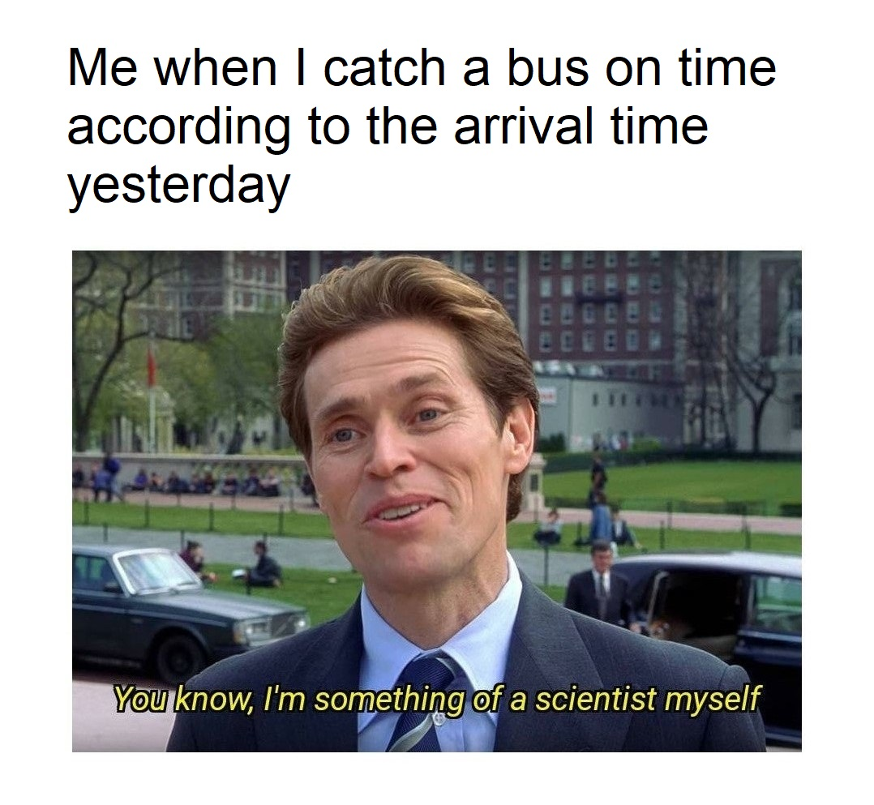
Empirical tactic

Slide 9
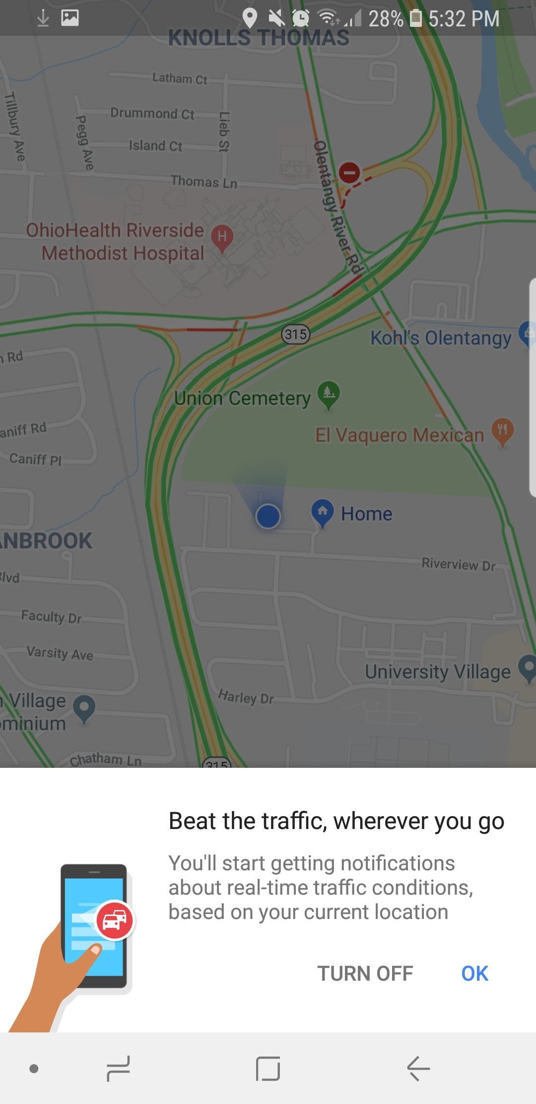
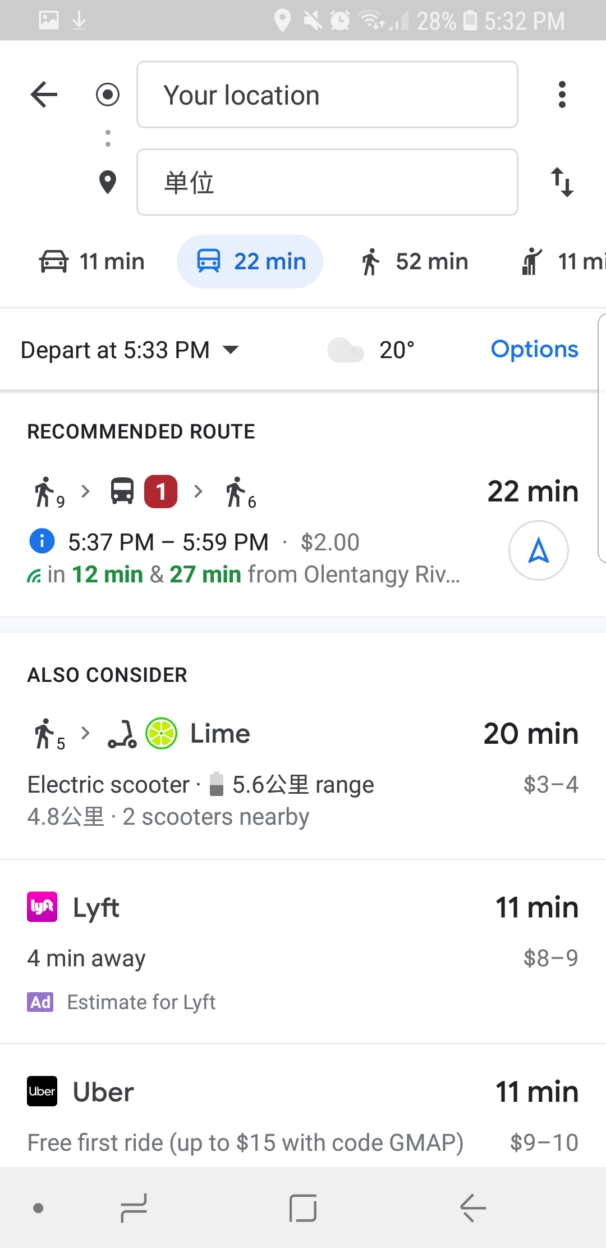
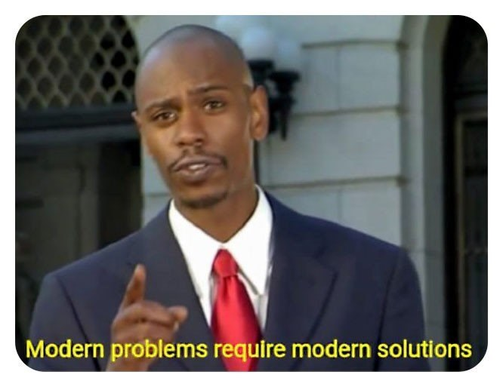

Slide 10
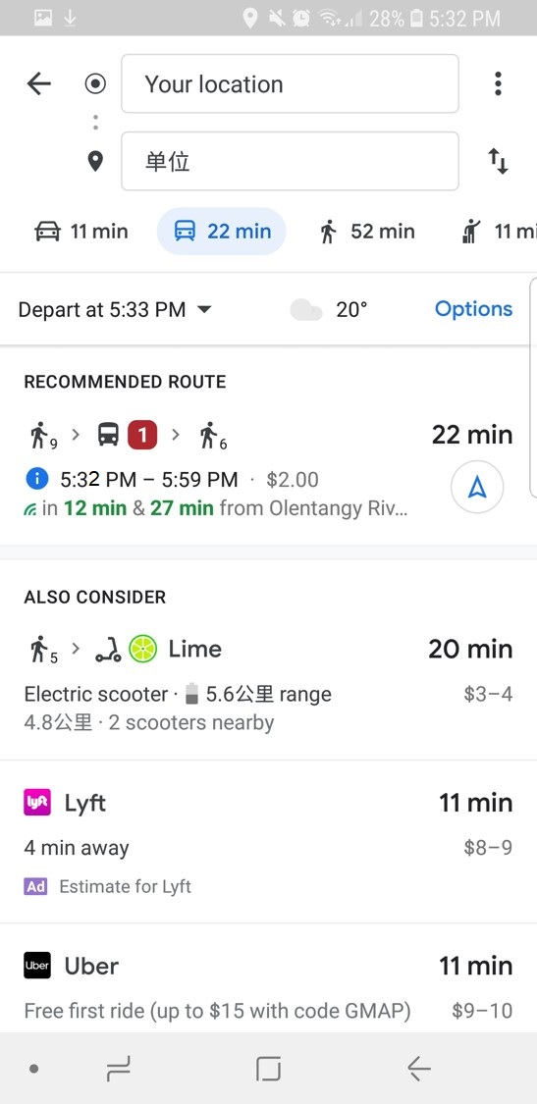

Greedy tactic

Slide 11
Greedy tactic

Slide 12

Prudent tactic
Leave a 5 minutes time buffer!

Slide 13
Prudent tactic
Leave a 5 minutes time buffer!

Slide 14


Optimal prudent tactic

Slide 15
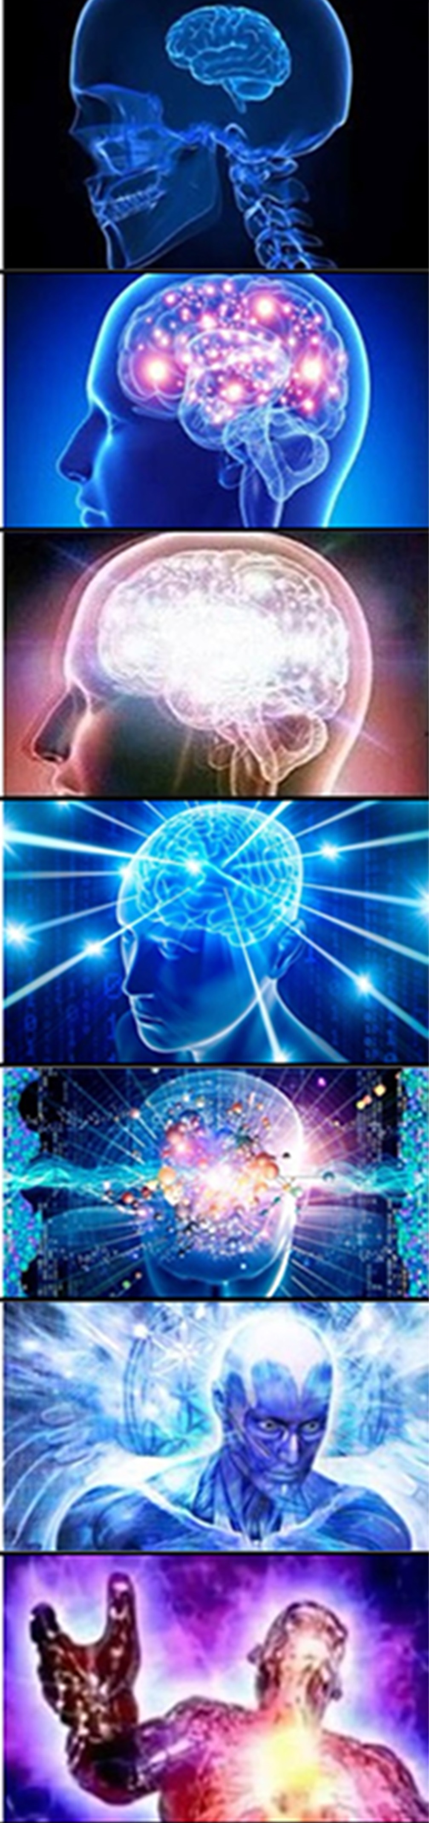
Performance
Aka, how good are these trip planning strategy
Postpone until the last second when the app tell you to leave
Greedy tactic
Leave home randomly
Arbitrary tactic
Follow your experience
Empirical tactic
Follow the schedule
Schedule tactic
≈
Leave a well-optimized time buffer before the app’s suggested time
Optimal prudent tactic
Live at the bus stop

Slide 16
Performance
Postpone until the last second when the app tell you to leave
Greedy tactic
Leave home randomly
Arbitrary tactic
Follow your experience
Empirical tactic
Follow the schedule
Schedule tactic
≈
Leave a well-optimized time buffer before the app’s suggested time
Optimal prudent tactic
Live at the bus stop

Slide 17
Performance
Postpone until the last second when the app tell you to leave
Greedy tactic
Leave home randomly
Arbitrary tactic
Follow your experience
Empirical tactic
Follow the schedule
Schedule tactic
≈
Leave a well-optimized time buffer before the app’s suggested time
Optimal prudent tactic
Live at the bus stop

Slide 18
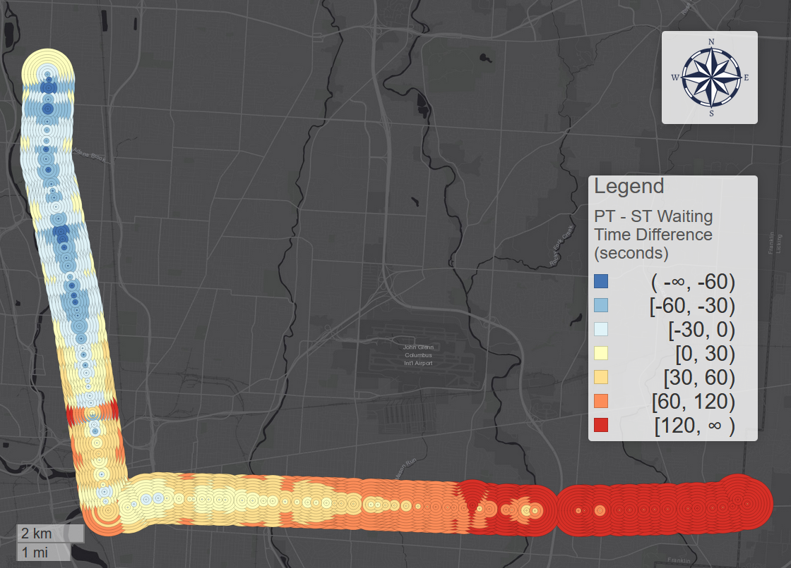
Does mobile apps help save time?
Helping
Bus direction
Not helping

Slide 19
Does mobile apps help save time?
Destination: Helping
Live near the destination;
Real-time information helps more!
Start: Not helping

Slide 20
Does mobile apps help save time?
Destination: Helping
Live near the destination;
Real-time information helps more!
Start: Not helping

Slide 21
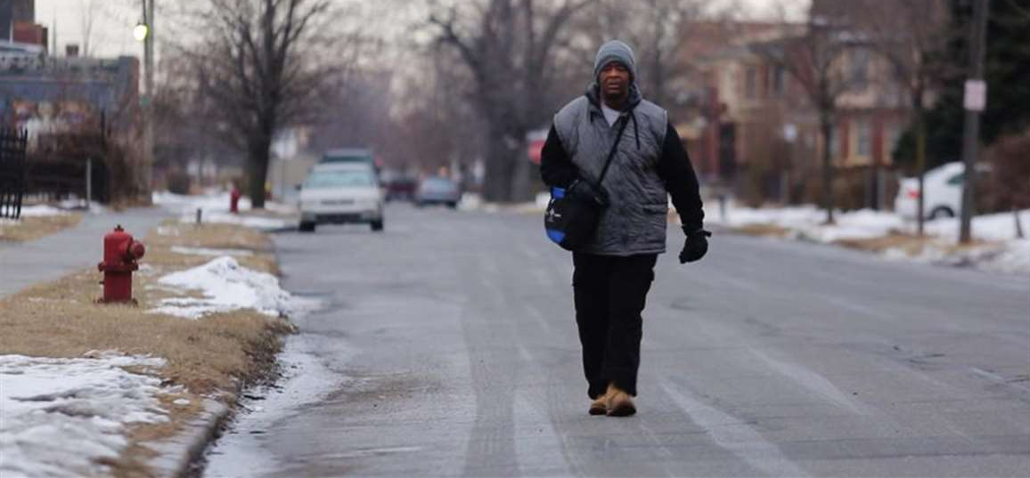
Distance from home
James Robertson, 56, of Detroit walks toward Woodward Avenue to catch his morning bus to Somerset Collection in Troy before walking to his job at Schain Mold

Slide 22
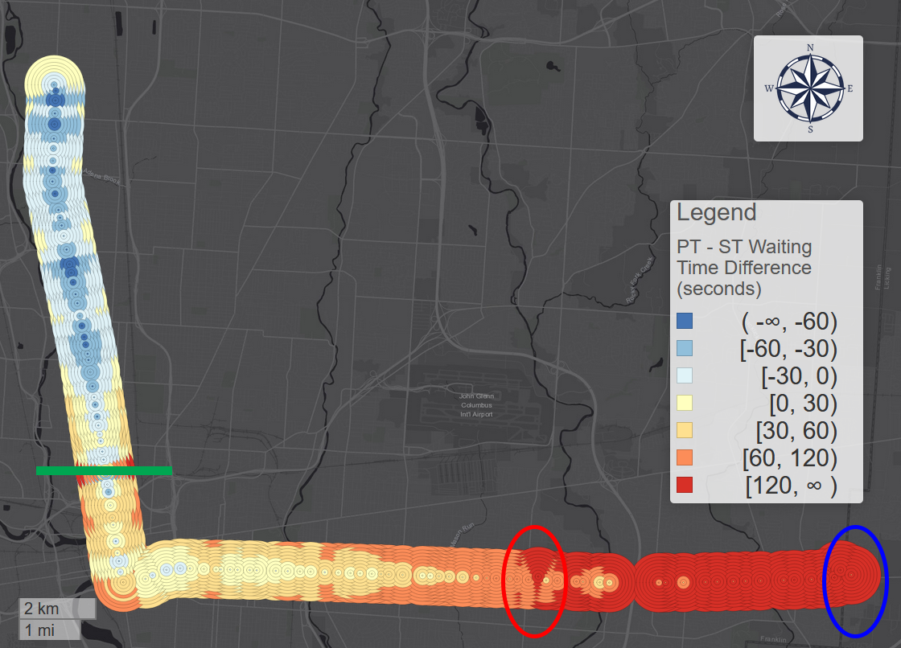
Does mobile apps help save time?
Not helping
Helping
Live further from the stop;
real-time information/apps help less!
Not helping
Bus direction
Helping

Slide 23
Thanks!
liu.6544@osu.edu

